Slide 1
Hypothesis Testing and Statistical Tests
Lesson 7.3

Slide 2
Class Objectives
By the end of today’s class, you will be able to:
Explain the difference between a null hypothesis and an alternate hypothesis.
Apply a one-sample t-test to determine if sample and population data are significantly different.
Apply a two-sample t-test to determine if two groups are significantly different.
Apply ANOVA to compare the means of three or more groups.
Perform a chi-square test to compare the distribution of categorical data.

Slide 3
Intro to Hypothesis Testing
Notes:
1.2 Instructor Do: Intro to Hypothesis Testing (0:15)

Slide 4
Hypothesis testing can be confusing at times, mostly because you must create your null and alternative hypotheses before performing any analysis.

Slide 5

Hypothesis Testing
A hypothesis statement is an educated guess about something.
The hypothesis is often expressed as an if/then statement.
01
02
Hypothesis testing in statistics is a way to test the results of a survey or an experiment to determine if they are meaningful.
We test for two mutually exclusive outcomes:
The null hypothesis
The alternative hypothesis

Slide 6
Hypothesis Testing
Null and alternative hypotheses:
Null hypothesis (H₀)
Alternative Hypothesis (H_{a})
The null hypothesis is the hypothesis that we are trying to disprove; it states that no statistical significance exists between the two variables.
Your null hypothesis assumes that your results happened by chance.
The alternative hypothesis is the opposite of the null hypothesis; it assumes that some factor influenced the results—meaning that they did not happen by chance.
Moving forward, we will refer to the alternative hypothesis as just the hypothesis.

Slide 7
Null and Alternative Hypotheses: Example
Null Hypothesis:
Migraine severity when taking the new drug is the same when taking the old drug.
Alternative Hypothesis: Migraine severity when taking the new drug is statistically significantly better or worse than when taking the old drug.
10
9
8
7
6
5
4
3
2
1
0
40%
Placebo
Migraine Severity
30%
Old drug
30%
New drug
% of Patients (n=2,000)

Slide 8
Hypothesis Testing
Steps for hypothesis testing:
01
Determine the hypothesis and null hypothesis.
02
Identify the appropriate statistical test.
03
Determine the acceptable significance value.
04
Compute the p-value.
05
Determine if the p-value rejects the null hypothesis by comparing it to the significance value (typically, p < 0.05).

Slide 9
In an analysis, we test the hypothesis and decide whether we can reject the null hypothesis. If we can, the only option left is the alternative hypothesis!

Slide 10
Partner Activity: Forming a Null Hypothesis
In this activity, you and your partner will turn two provided questions into a hypothesis and a null hypothesis.
10 minutes
Notes:
1.3 Partners Do: Forming a Null Hypothesis (0:10)

Slide 11
Partner Activity: Forming a Null Hypothesis
Instructions | Convert the following questions into a hypothesis and a null hypothesis. Does dark chocolate affect arterial function in healthy individuals? Does coffee have anti-aging properties?

Slide 13
Does dark chocolate affect the arterial function in healthy individuals?
Hypothesis: If dark chocolate is related to arterial function in healthy individuals, consuming 30 grams (g) of dark chocolate daily for one year will result in improved arterial function.
Null Hypothesis
Alternative Hypothesis
Consuming 30 g of dark chocolate daily for one year
will result in no improvement in arterial function.
Consuming 30 g of dark chocolate daily for one year will result in improvement in arterial function.

Slide 14
Does coffee have anti-aging properties?
Hypothesis: If coffee consumption is related to anti-aging properties, consuming 400 milligrams (mg) of coffee daily will reduce mortality from age-related diseases, such as heart disease.
Null Hypothesis
Alternative Hypothesis
Consuming 400 mg of coffee daily will result in an equal or greater rate of heart disease.
Consuming 400 mg of coffee daily will result in a reduction in the rate of heart disease.

Slide 15
​​T-Tests

Slide 16
A t-test tells you how significant the differences between groups are.
It lets you know if the differences, measured in means (averages), could have happened by chance.

Slide 17
Calculating a T-Test
x1
 | Mean of the first dataset
 | Mean of the second dataset
 | Standard deviation of the first dataset
 | Standard deviation of the second dataset
 | Number of elements in the first dataset
 | Number of elements in the second dataset
(x1 -
x2)
x2
t=
s1²
s1² - s2²
s2²
n1
-
n1
n2
n2

Slide 18
​​T-Tests
One-sample t-test
Independent t-test
Determines whether the sample mean statistically differs from a known or hypothesized population mean.
Determines whether there is a statistically significant difference between the means in two unrelated groups.
An independent t-test is also known as a two-sample t-test.

Slide 19
What type of t-test should I use?

Slide 20
​​T-Tests
There are couple of things to consider before performing t-test:
01
Do the compared groups come from a single population or two distinct populations?
02
Do you want to test the difference in a specific direction?

Slide 21
​​T-Tests
One-sample t-test
Independent t-test
One group being compared against a standard value
Example: Comparing gasoline octane level to an octane level
Groups coming from two distinct populations
Example: Different countries, different species

Slide 23
Activity: T-Test
In this activity, you will use a t-test to compare the difference in heights of non-related individuals from two different locations.
15 minutes

Slide 24
Activity: T-Test
Instructions | Calculate the mean for each population.
 | Use a t-test to determine if there is a statistically significant difference in the height of non-related individuals in San Francisco vs. Denver.
 | It is up to you to determine if you should use a one-sample or an independent t-test.

Slide 26
ANOVA

Slide 27
ANOVA
01
02
03
ANOVA is an extension of a t-test. With a t-test, you can test two groups to determine whether their means are statistically different.
An ANOVA test is a way to find out if survey or experiment results are significant.
It helps you figure out whether to reject the null hypothesis or to fail to reject it.

Slide 28
Activity: ANOVA
In this activity, you will use ANOVA to compare the differences in pain tolerance based on how many times a person exercises in a given week.
10 minutes

Slide 29
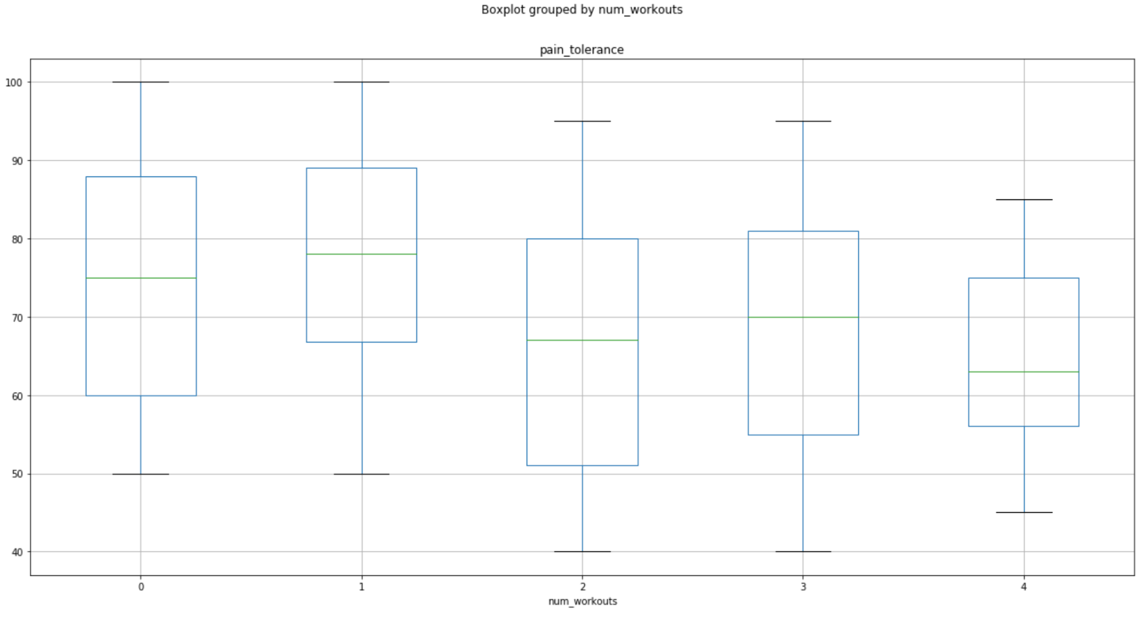
Activity: ANOVA
Instructions | Perform a one-way ANOVA test to determine whether there are any significant differences in number of workouts vs. pain threshold.
 | Create a box plot to show the distribution of pain tolerances for number of workouts.

Slide 31
Chi Square
Chi Square

Slide 32
The Chi-Square Test
What is it used for?
To answer the question: Is the distribution of frequencies in the dataset meaningful?
In other words, does the data match our expectations?
Stated another way: Do we reject the null hypothesis or fail to reject it?

Slide 33




The Chi-Square Test
Example: Out of 300 dinosaurs…
220 eat everything
55 eat
only meat
25 eat
only plants
Null hypothesis:
No statistical significance exists in the distribution of omnivores, carnivores, and herbivores. That is, this data can be explained by random distribution.
The chi-square test can help us reject or fail to reject the null hypothesis.
Notes:
----------------------------------------
AdobeStock_58138709
AdobeStock_223020343
AdobeStock_208324741

Slide 34

The Chi-Square Python Function
How is the chi-square test used?

Slide 35
Degrees of Freedom
To determine the degree of freedom (df), take the number of rows and subtract 1:
Omnivores | 220
Carnivores | 55
Herbivores | 25
There are three rows, so the
degree of freedom is 3 – 1 = 2
The degree of freedom is the number of figures required to fill out the table (like Sudoku).
If we have two of the numbers, we can figure out the value of the third.

Slide 36
P-value
The p-value is the confidence level, or the acceptable risk of a false positive.
p = 0.05 is widely accepted in academia but may be higher in business settings.
Importance of Findings | Significance Level | Probability of Being Wrong
Low | 0.1 | 1 in 10
Normal | 0.05 | 5 in 100
High | 0.01 | 1 in 100
Very high | 0.001 | 1 in 1,000
Extreme | 0.0001 | 1 in 10,000
We’ll say 0.05 in this example.

Slide 37
The Chi-Square Test Formula
A few more considerations:
The chi-square test is used to test categorical variables; it can’t be used on continuous data.
The categories must be mutually exclusive.
We covered using the chi-square test formula to test goodness of fit.
It can also be used to test independence. Feel free to explore this more on your own.

Slide 38

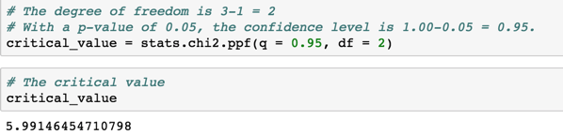
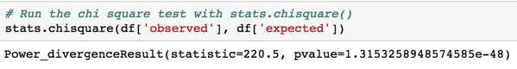
Using the Chi-Square Test In Python
Import the scipy.stats module.
Determine the critical value.
Run the chi-square test.

Slide 39
Activity: Chi Square
In this activity, you will perform the chi-square test, first in Python and then by hand.
10 minutes

Slide 40
Activity: Chi Square
Instructions | You are the owner of four cafés in a town of avid coffee drinkers.
 | Using a chi-square goodness-of-fit test, determine whether the results suggest that customers are more likely to frequent one café over another.
 | Perform the necessary calculations using Python.
 | Then, perform the calculations by hand to verify your findings.
 | Use a p-value of 0.05.
 | Consult a chi-square table to find your critical value: https://www.medcalc.org/manual/chi-square-table.php
 | On your student repository, open Stu-Cafes.ipynb.

Slide 42


